Slide 1
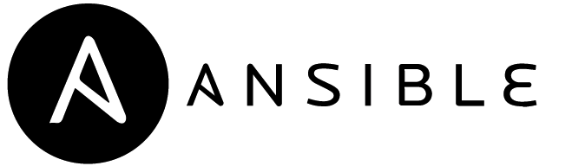
DevOps Methods for Automation of Server Management using Ansible
PRESENTED BY:
PRANAV T P
1CG16CS071
DEPT. OF CSE,
CIT, GUBBI

Slide 2
Agenda
What is DevOps
What is Ansible
Ansible Architecture
Ansible Workflow
Conclusion

Slide 3
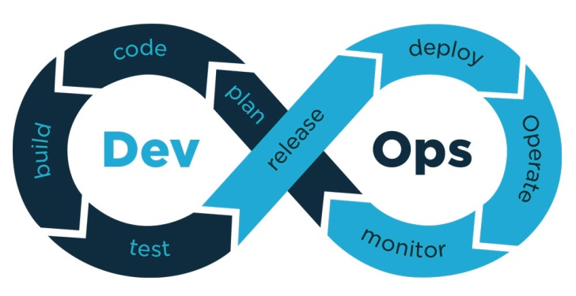
What is DevOps?
DevOps is a set of practices that combines software development and IT operations.
It will be a set of tools that help organizations build, and use software reliably and efficiently.
It is a methodology meant to improve work throughout the software development lifecycle.

Slide 4
What is Ansible?
Ansible is an open-source configuration management and provisioning tool.
It uses SSH to connect to servers and run the configured Tasks.
Ansible lets you to control and configure nodes from a single machine.
What makes it different from other management software is that Ansible uses SSH infrastructure.
This project was founded in 2013 and brought by RED HAT in 2015.

Slide 5
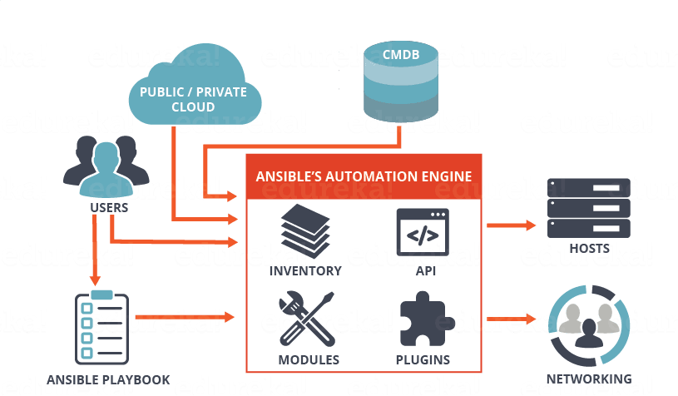
Architecture of Ansible

Slide 6
Playbook
Playbooks are simple YAML files. These files are descriptions of the desired state of your systems.
Playbooks are simple to write and maintain.
They are written in a natural language so they are very easy to evolve and edit.
Playbook contains Plays.
Plays contain tasks.
tasks call modules.

Slide 7
EXAMPLE OF ANSIBLE
Create yaml file
---
- hosts: all #server host or group name
become: yes
tasks:
- name: install apache2
apt: name=apache2 update_cache=yes state=latest
Run the file:
ansible-playbook filename.yaml

Slide 8
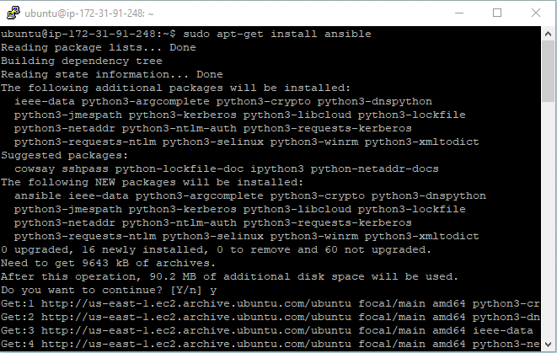
Ansible Workflow
Install Ansible
.

Slide 9
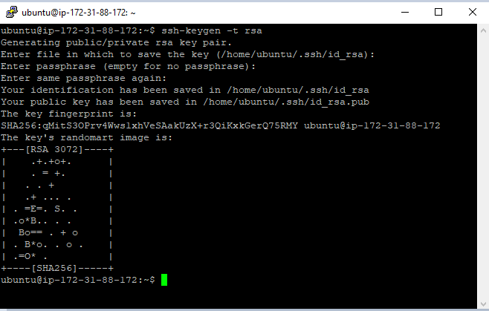
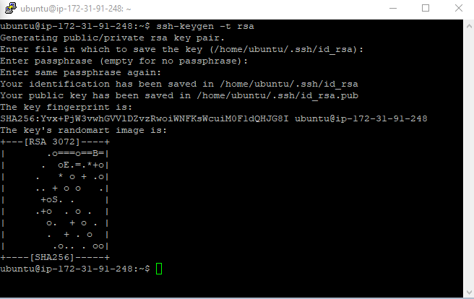
Generate a RSA keys

Slide 10
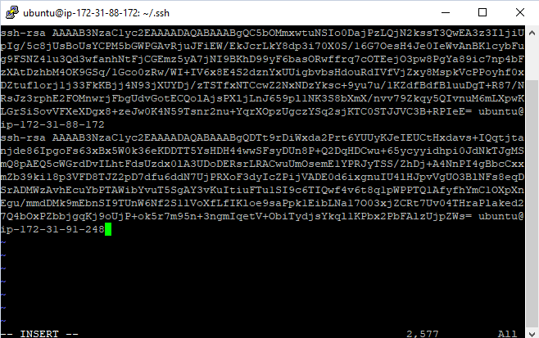
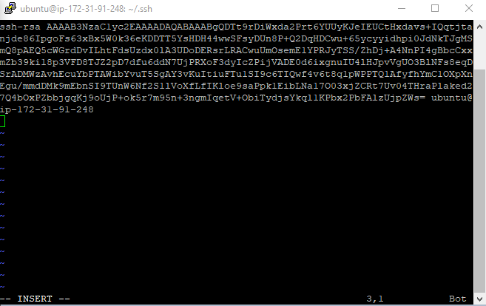
Configuring host file

Slide 11
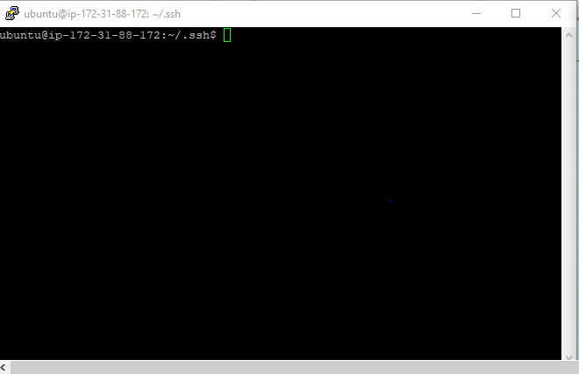
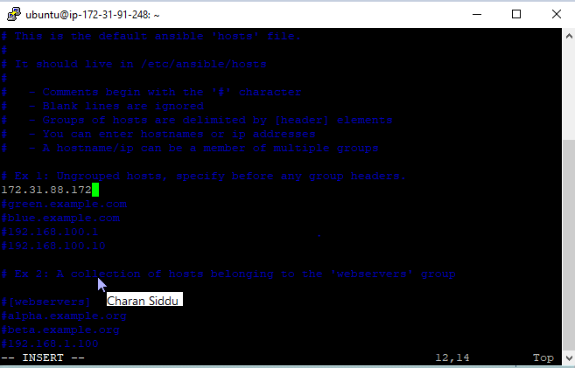
Update the IP Address

Slide 12
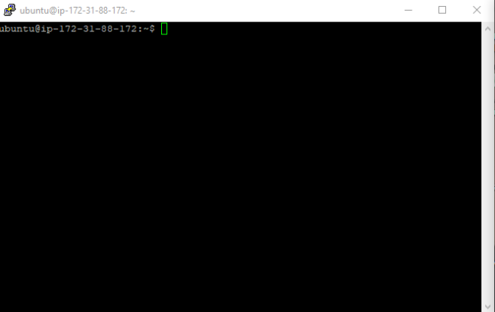
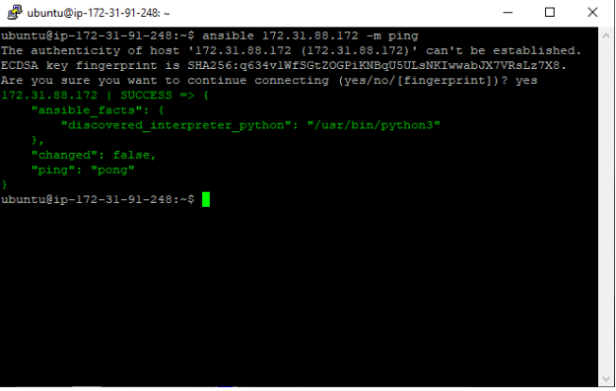
Ping the IP Address

Slide 13
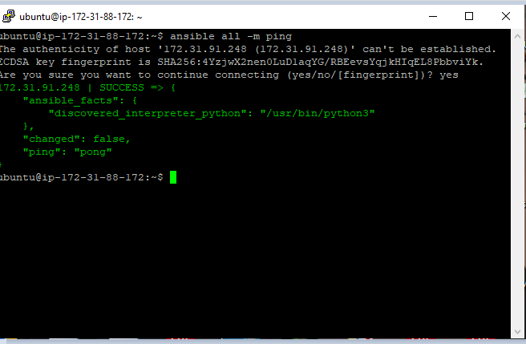
Connection test with Ansible basic command

Slide 14
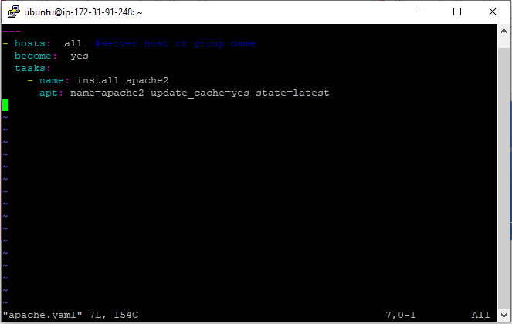
Create a yaml file

Slide 15
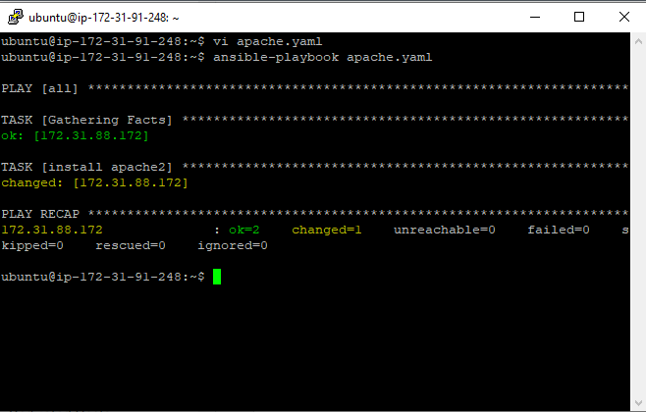
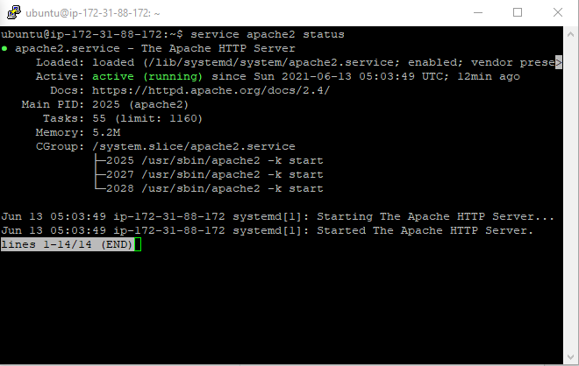
Apache Installation

Slide 16
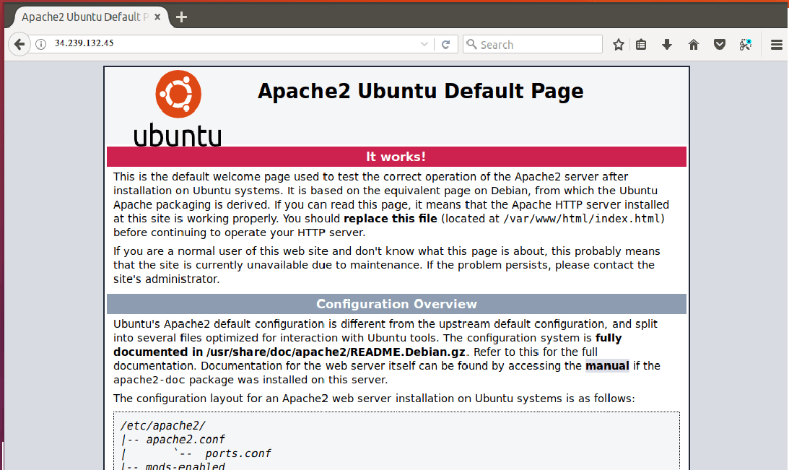
Check the installation

Slide 17
Conclusion
Infrastructure design is a software life cycle step that defines and tailors software infrastructure requirements, including the number and form of material managers or required hardware. Infrastructure construction often requires a large amount of installation and maintenance documentation required to do things like:
(i) strengthening and connecting the equipment needed (either physical or physical) for the software to work,
(ii) installing and repairing the required software and purchases within the virtual machine,
(iii) to strengthen and run the support resources needed for the software to be used.

Slide 18
Thank You Everyone!!
.

